Slide 1

Exploring Metacritic Videogame Reviews
Jeremy Osir
NYDSA, Oct 2021
Notes:
Hi, thank you for joining the presentation today, where I will be presenting an analysis of Metacritic video game reviews

Slide 2
Table of Contents
Introduction
Project Objectives
Web Scraping Process
Exploratory Data Analysis
Main Takeaways
Follow Up Research
Notes:
Here’s a quick overview of the presentation

Slide 3
The videogame industry is booming
In 2020 the industry was valued at $155 Billion. (Statista)
For comparison, the global entertainment market — consisting of theatrical and home entertainment — was valued at $100 Billion in 2020. (Motion Picture Association)
Analysts forecast that the industry will be worth nearly $300 Billion by 2026.
Similar to other forms of popular entertainment, there is a thriving “review economy” that seeks to inform consumers/developers about the subjective quality of games.
This project will focus on exploring review trends amongst users and critics.
Notes:
First, I thought it would be worth providing some context on the videogame industry.
The industry is growing rapidly. Expected to double in size within the next 5 years
Focusing on investigating trends/differences in how critics perceive games compared to users/gamers

Slide 4
Project Overview
Objective: Scrape videogame review scores by critics and users (gamers) from Metacritic and conduct exploratory data analysis to uncover any underlying patterns.
Metacritic Overview: a website that aggregates both user and critic reviews of films, TV shows, music albums, video games.
Critic review scores are weighted averages with more relative influence given to certain publications “because of their quality and stature”.
Research Questions:
Have average critic and user review scores changed over time?
What genres are the highest reviewed by critics? Is this the same for users?
What platforms have the highest review scores, on average?
Which game developers have the highest review scores, on average?
Notes:
Metascores range from 0-100, with higher scores indicating better overall reviews. (minimum = 4 reviews)

Slide 5
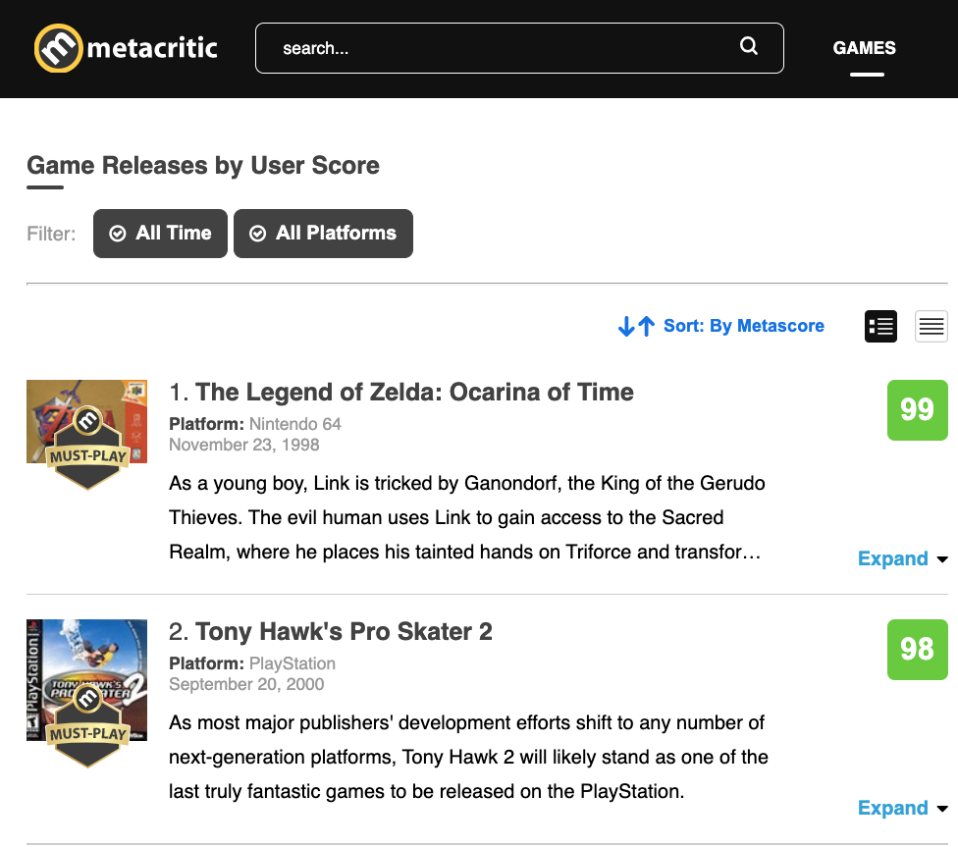
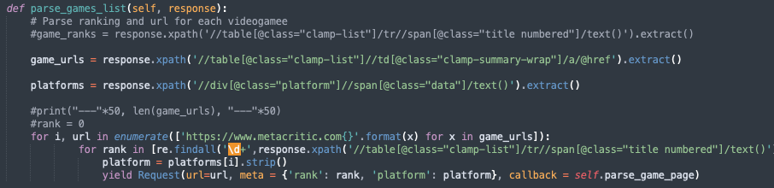
Webscraping Overview
Step 1:
Started by going to the Metacritic webpage that lists all videogames titles ranked according to their review score.
Used Scrapy to pull the following fields from the main ranking page:
Game URL: Titles were hyperlinks
Rank
Platform
Spider crawled through~189 pages, each containing ~100 games

Slide 6
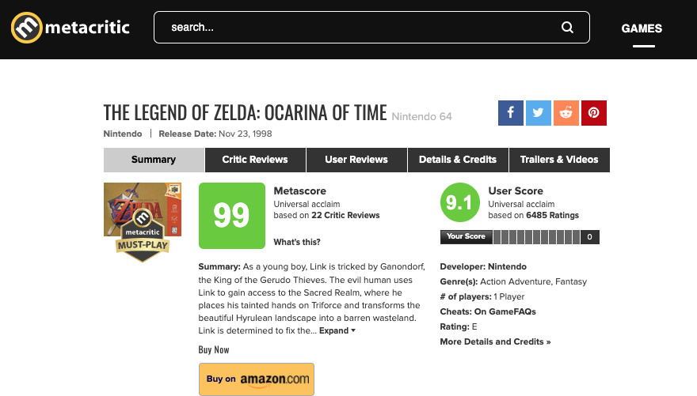
Webscraping Overview
Step 2:
Next, navigated to each title’s URL using regex pattern matching and pulled the following fields:
Game Title
Release Date
Metascore (critic score)
User Score
Number of critic reviews
Number of User reviews
Genre(s)
# of players
Spider crawled through each title’s URL to pull this info.
Scraping process took ~ 12 hours

Slide 7
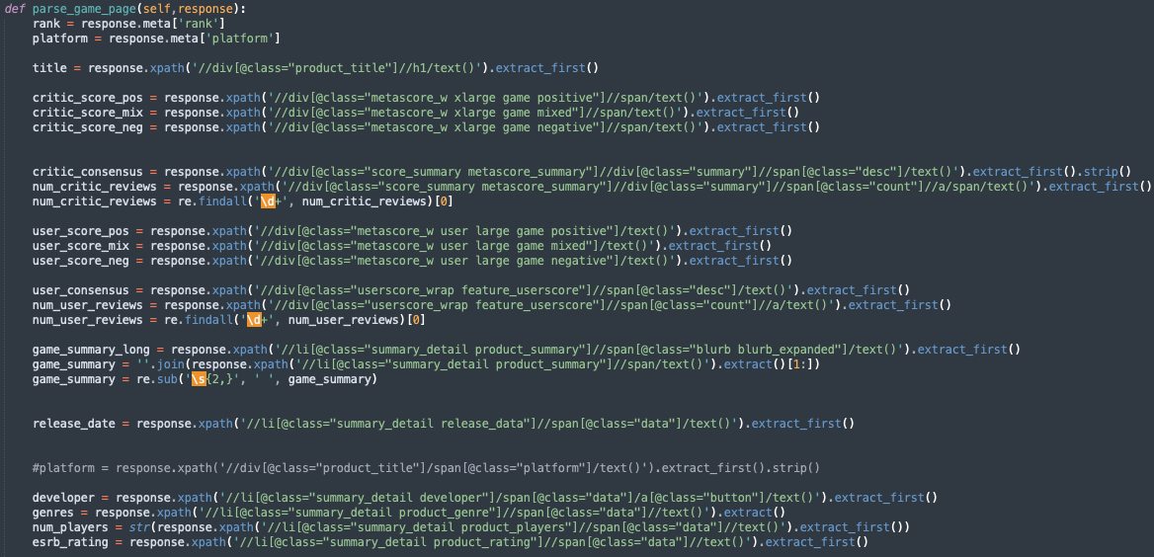
Webscraping Overview

Slide 8
Pre-processing
Overview of dataset:
csv file containing 17,087 rows and 20 columns
Main pre-processing tasks:
Convert "release date" column from character to date
Create new column that extracts the year from “release date”
The critic and user review scores were stored in different columns based on whether they were positive, mixed, or negative.
>> Used dplyr library to create a new column “critic_score” to store all the critic reviews, and “user_score” to store all the user reviews.
The critic scores were on a 1-100 scale, while the user scores are 1-10 (to 1 decimal place). Scaled the critic score by 0.1 to match the user score.
Genres are all stored in one column. Split each title’s genres into separate columns

Slide 9
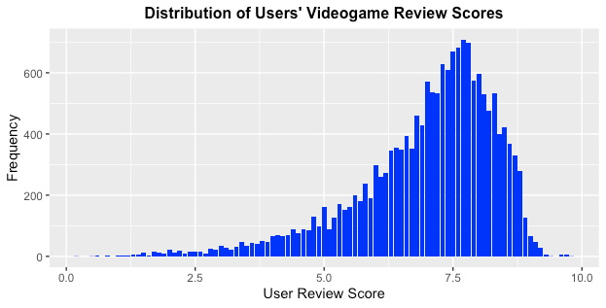
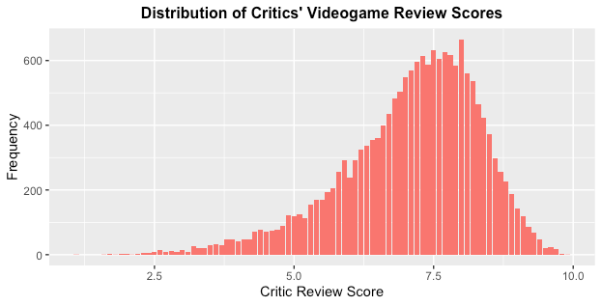
Exploratory Data Analysis
The distribution of review scores by users and critics generally look quite similar, with both having a left skew.

Slide 10
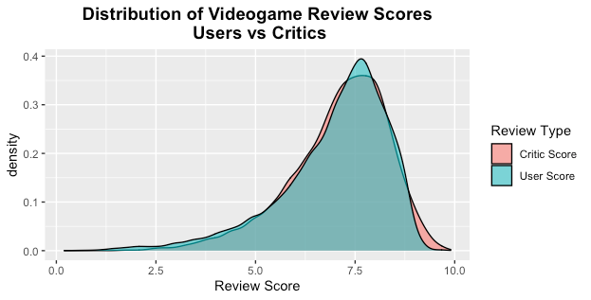
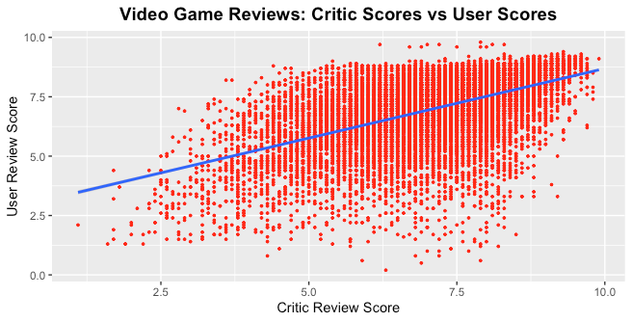
Critics tended to award higher scores
Overlaying the two distribution charts shows the similarity between the two but highlights a few differences: Critics gave more extreme “high” scores.
A Pearson’s correlation test of user and critic scores found a statistically significant correlation of 0.53, indicating a moderately positively correlated.

Slide 11
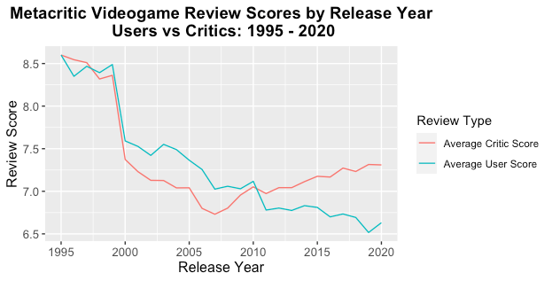
On average, review scores have declined over time
Notes:
Noticed that the difference between user and critic scores seem to be widening

Slide 12
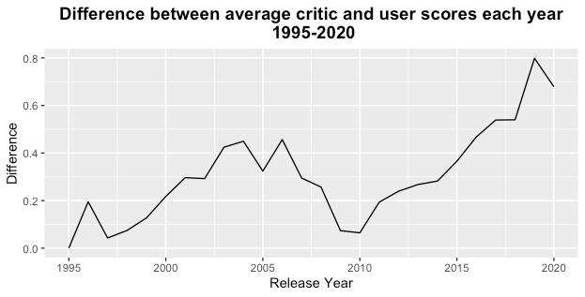
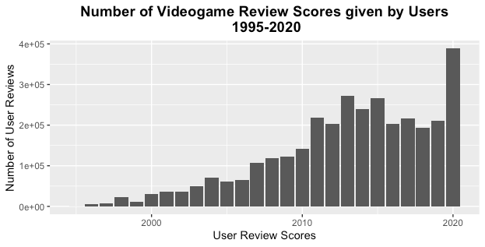
The difference between user and critic scores has widened as the number of user reviews has increased
Note: The number of reviews provided by critics has stayed relatively flat during this period

Slide 13
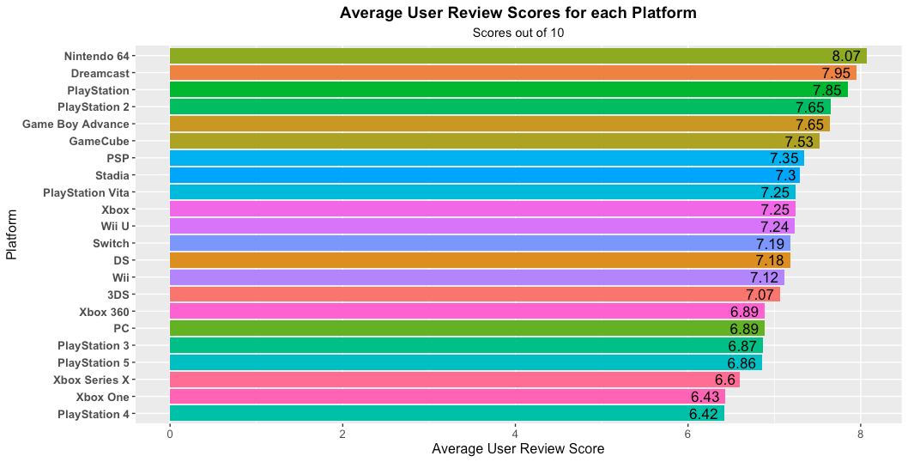
Users tended to rate older platforms highest

Slide 14
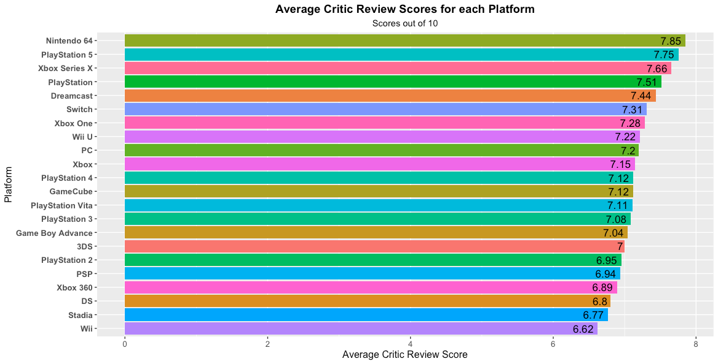
Critics had a mix of old and new platforms in their highest rated list

Slide 15
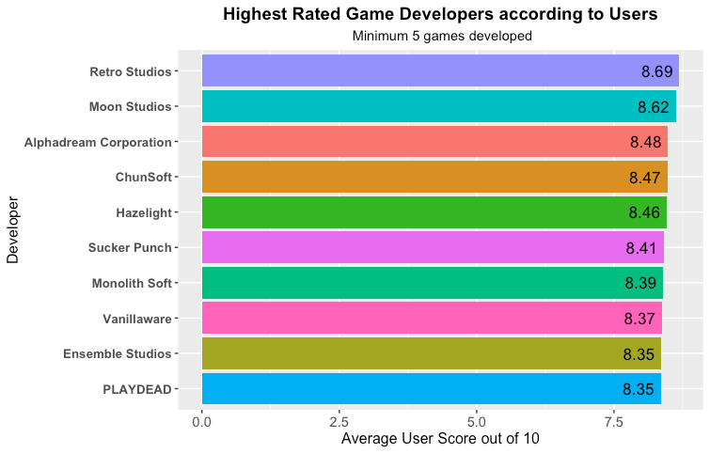
Users’ top rated game developers

Slide 16
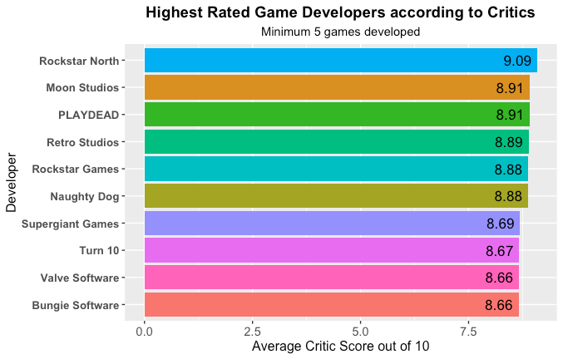
Critics’ top rated game developers

Slide 17
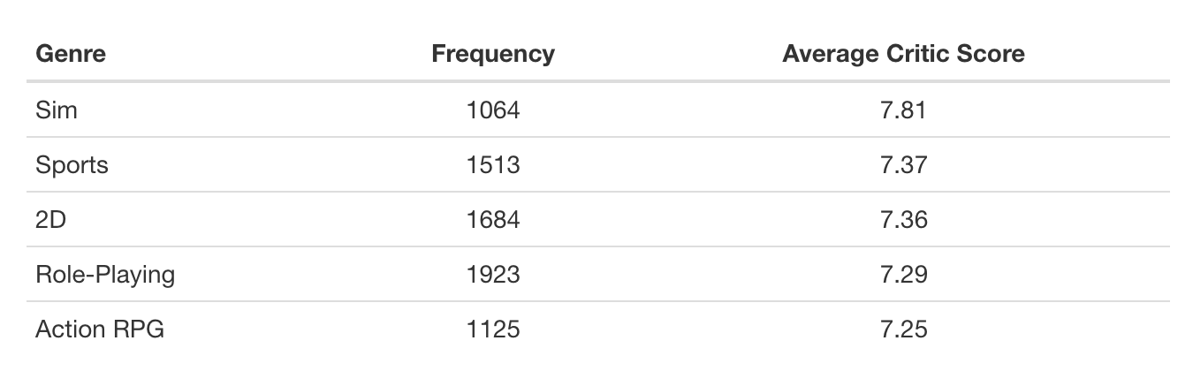
Highest rated genres according to critics
(min: 1000 occurrences)

Slide 18
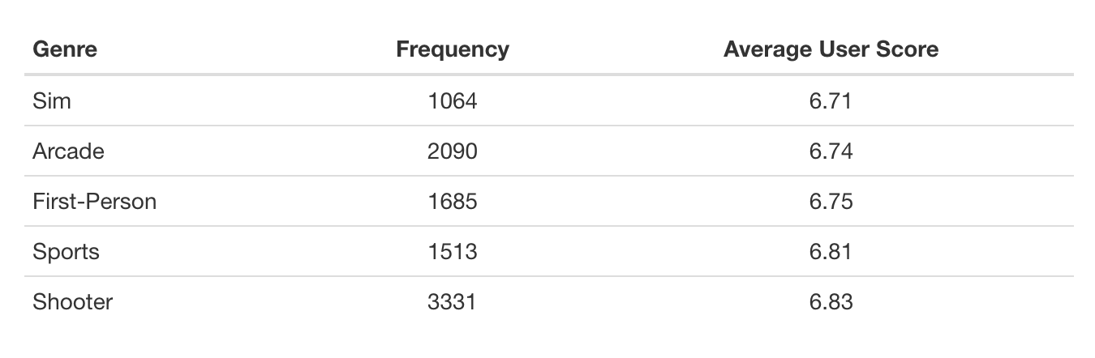
Highest rated genres according to users
(min: 1000 occurrences)

Slide 19
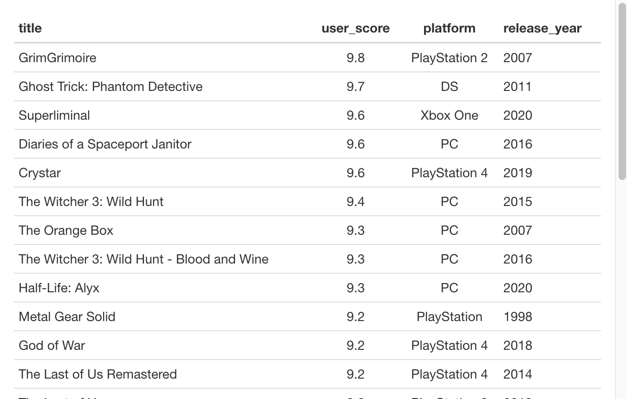
Users’ Hall of Fame: Top Reviewed Titles
(min: 1000 reviews)

Slide 20
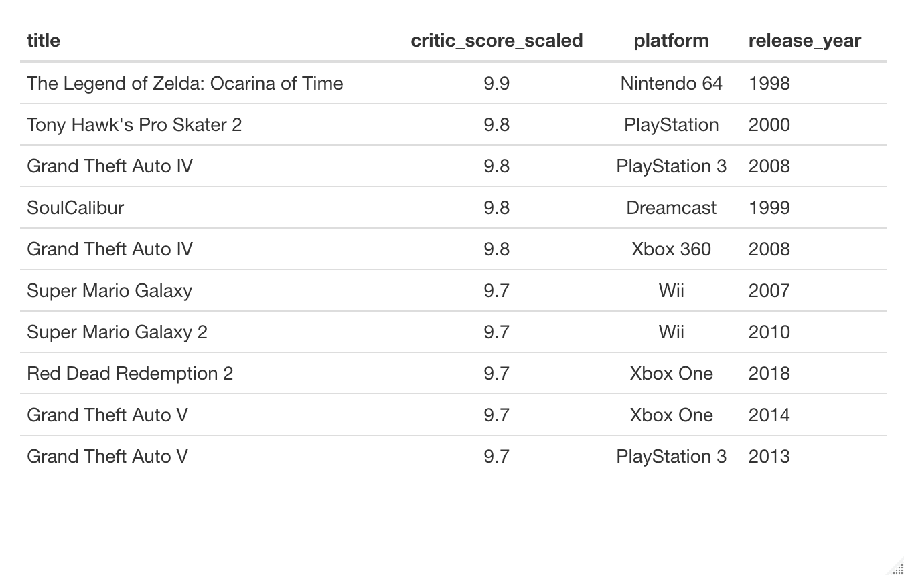
Critics’ Hall of Fame: Top Reviewed Titles
(min: 1000 reviews)

Slide 21
Main Takeaways
Average videogame review scores have declined over time.
Divergence between user and critics is widening, as the number of users providing scores has increased.
Genres: Simulation Games and Sports Games were both popular amongst critics and users.
Platforms: The Nintendo 64 was the highest rated console by both users and critics. Overall, users favored older game platforms while critics were more balanced.

Slide 22
Future Research
Explore the underlying factors that are contributing to lower scores
NLP analysis of review text to further explore downward trend in average review scores by users and critics
Compare Metacritic reviews with other review sites
Supplement with videogames sales data to investigate relationship between reviews scores and sales performance
Examination of genre combinations to investigate whether certain combinations are more likely to be reviewed positively or negatively
Notes:
Metacritic critiques: Convert grade to quantitative scores

Slide 23
Credits
This presentation has been designed using resources from PoweredTemplate.com
Title Slide Photo by Cláudio Luiz Castro on Unsplash
Videogame review data pulled from Metacritic (metacritic.com)
Statista (videogame industry data)

